Slide 1
Preparing ACCESS for CMIP6
Simon Marsland | CSIRO

Slide 2


Thanks
CSIRO ACCESS Coupled Climate Modelling Team
NESP ESCC Hub
ARCCSS, UM Partners, COSIMA, NOAA/GFDL, …

Slide 3
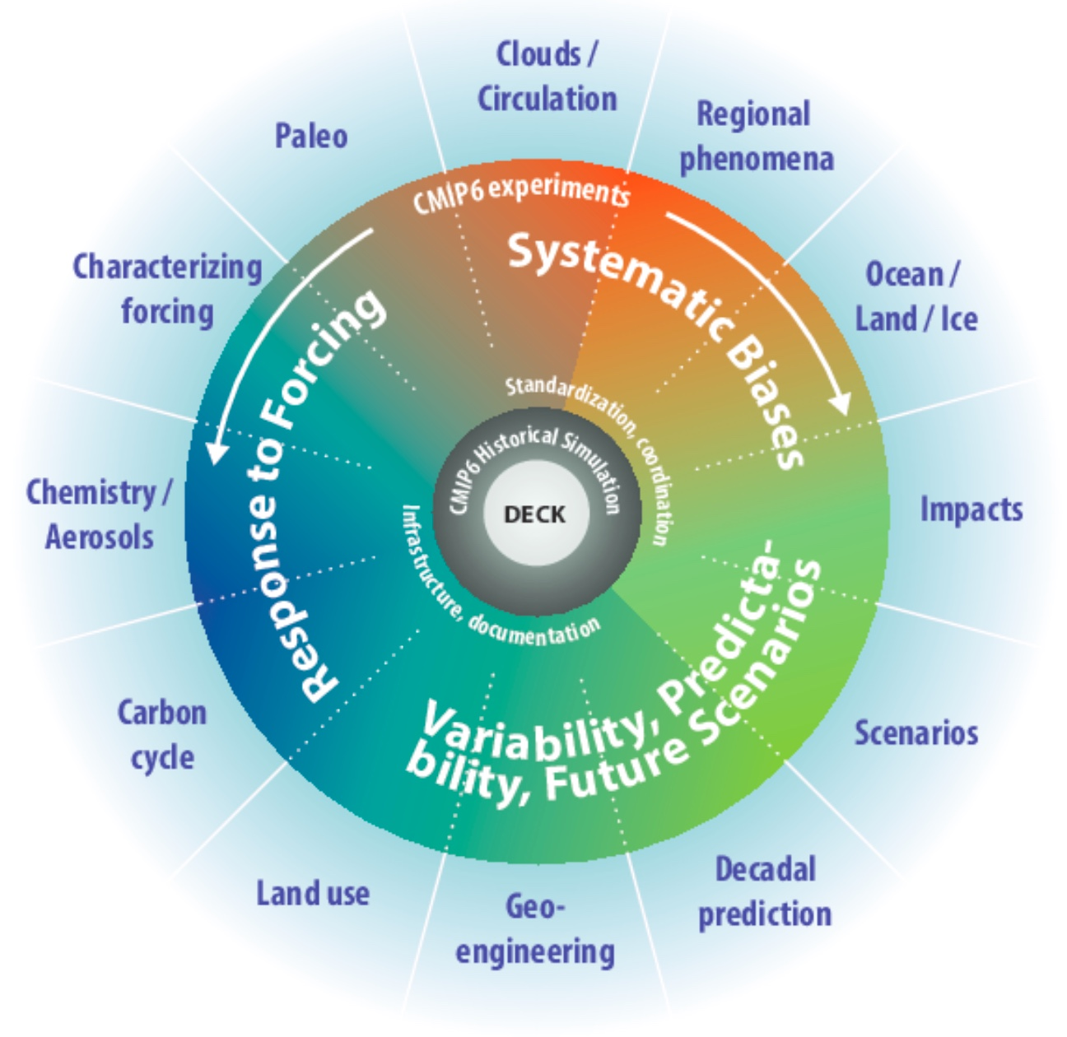
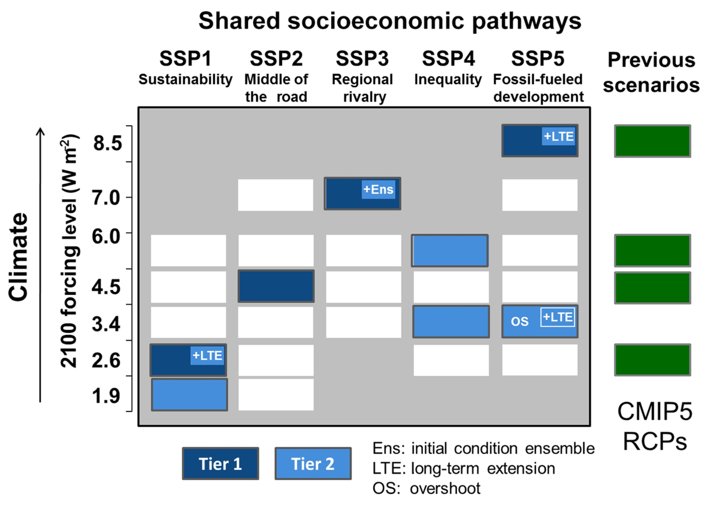
CMIP6
Eyring et al., 2016
Eyring et al., 2016
O’Neill et al., 2016

Slide 4
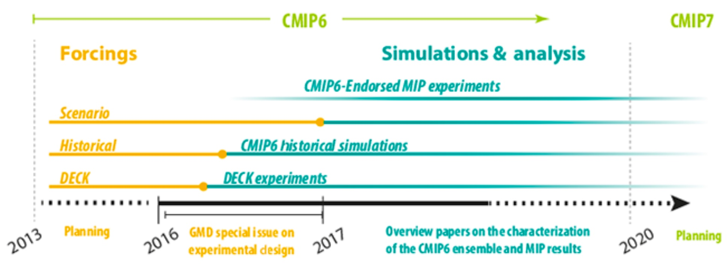
Challenges
Eyring et al., 2016
Timelines slipping
Staff losses
Late CMIP6 forcings
UKMO Global Atmosphere version 6 (GA6) – poor climate due to poor aerosols
Late GA7, later GA7.1
Computational cost (slow turnover)
CABLE technical coupling (2017 used JULES as back-up)
Quality of solution – model biases
CABLE dust tuning (about half of JULES dust)
ENSO periodicity (too frequent)

Slide 5
Program:
14:00-14:10 Simon Marsland - Preparing ACCESS for CMIP6 - Introduction
14:10-14:25 Arnold Sullivan - Status of multi-century pre-industrial ACCESS-CM2 simulations
14:25-14:40 Roger Bodman - AMIP simulations
14:40-14:55 Martin Dix - ACCESS and CABLE
14:55-15:10 Siobhan O’Farrell - Sea Ice and Icebergs
15:10-15:25 Tilo Ziehn - ACCESS-ESM1.5
15:25-15:40 Matt Chamberlain - ACCESS-ESM1.5 Ocean BGC
15:40-16:30 Discussion

Slide 6
Simon Marsland| simon.marsland@csiro.au 03 9239 4548

Slide 7
CMIP6 Model Intercomparison Projects (MIPs)
3 CMIP6 SCIENCE QUESTIONS
How does the Earth System respond to forcing?
What are the origins and consequences of systematic model biases?
How can we assess future climate changes given climate variability, predictability and uncertainties in scenarios?
7 WCRP GRAND CHALLENGES
Clouds, Circulation and Climate Sensitivity
Melting Ice and Global Consequences
Weather and Climate Extremes
Water for the Food Baskets of the World
Regional Sea-Level Change and Coastal Impacts
Carbon Feedbacks in the Climate System
Near-term Climate Prediction
Eyring et al., 2016

